Slide 1

Tomato Leaf Disease Identification by Restructured Deep Residual Dense Network
BY
    K. Mahesh Babu 18831A0578
    K. Mahikshit 18831A0583
    K. Rithika 18831A0567
Under the Guidance of
Mr. A.Rajesh
(Associate Professor)

Slide 2
CONTENTS
Abstract
Introduction
Literature Survey
Existing System
Drawbacks of Exisitng System
Proposed System
Methodologies
Future Enhancement
Conclusion

Slide 3
Abstract
As COVID-19 spread worldwide; many major grain-producing countries have adopted measures to restrict their grain exports; food security has aroused great concern from various parties. How to improve grain production has become one of the most important issues faced by all countries.
However, crop diseases are a difficult problem for many farmers so it is important to master the severity of crop diseases timely and accurately to help staff take further intervention measures to minimize plants being further infected.
A restructured residual dense network was proposed for tomato leaf disease identification; this hybrid deep learning model combines the advantages of deep residual networks and dense networks, which can reduce the number of training process parameters to improve calculation accuracy as well as enhance the flow of information and gradients.
The original RDN model was first used in image super resolution, so we need to restructure the network architecture for classification tasks through adjusted input image features and hyper parameters.
The restructured residual dense network model can obtain significant improvements over most of the state-of-the-art models in crop leaf identification, as well as requiring less computation to achieve high performance.

Slide 4
Introduction
Leaf diseases greatly influence crop growth and yield. Researchers have performed considerable work to effectively identify the severities of crop disease to present, the research on crop disease identification is mainly divided into two topics.
Using any one of the Computer Vision or Machine Learning methods, we can get acceptable results, but to predict in the level of a state-of the-art model, we combine the both topics and implement a custom RDN (Residual Dense Network), which uses components from both Computer Vision and Machine Learning.
The traditional Computer Vision methods are mainly based on spectral detection and feature extraction to identify different diseases. While the Machine Learning methods are used to identification of disease images is extracted by using supervised or unsupervised learning algorithms and the recognition is carried out through different features of diseased and healthy plants.
However, a combination of these methods are rarely applied to crop leaf disease identification that can balance accuracy and efficiency.
So, to combat this problem, we propose a restructured dense residual network that adjusts the structure and parameters. The purpose of this model is to improve the performance in crop leaf identification and reduce the impact of the disease on the crop as much as possible.

Slide 5
Literature Survey
TITLE: ImageNet Classification with Deep Convolutional Neural Networks
AUTHORS: Alex Krizhevsky, Ilya Sutskever, Geoffrey E. Hinton
YEAR: 2012
DESCRIPTION:
They trained a large, deep convolutional neural network to classify the 1.2 million high- resolution images in the ImageNet LSVRC-2010 contest into the 1000 different classes. On the test data, they have achieved top-1 and top-5 error rates of 37.5% and 17.0% which is considerably better than the previous state-of-the-art. The neural network, which has 60 million parameters and 650,000 neurons, consists of five convolutional layers, some of which are followed by max-pooling layers, and three fully-connected layers with a final 1000-way softmax. To make training faster, they have used non-saturating neurons and a very efficient GPU implementation of the convolution operation. To reduce overfitting in the fully-connected layers they have employed a recently-developed regularization method called “dropout” that proved to be very effective. They have also entered a variant of this model in the ILSVRC- 2012 competition and achieved a winning top-5 test error rate of 15.3%, compared to 26.2% achieved by the second-best entry.

Slide 6
TITLE: Going deeper with convolutions
AUTHORS: Christian Szegedy, Wei Liu, Yangqing Jia, Pierre Sermanet, Scott Reed, Dragomir Anguelov, Dumitru Erhan, Vincent Vanhoucke, Andrew Rabinovich
YEAR: 2012
DESCRIPTION:
They propose a deep convolutional neural network architecture codenamed Inception, which was responsible for setting the new state of the art for classification and detection in the ImageNet Large-Scale Visual Recognition Challenge 2014 (ILSVRC14). The main hallmark of this architecture is the improved utilization of the computing resources inside the network. This was achieved by a carefully crafted design that allows for increasing the depth and width of the network while keeping the computational budget constant. To optimize quality, the architectural decisions were based on the Hebbian principle and the intuition of multi-scale processing. One particular incarnation used in our submission for ILSVRC14 is called GoogLeNet, a 22 layers deep network, the quality of which is assessed in the context of classification and detection.

Slide 7
TITLE: Deep Residual Learning for Image Recognition
AUTHORS: Kaiming He, Xiangyu Zhang, Shaoqing Ren, Jian Sun
YEAR: 2015
DESCRIPTION:
Deeper neural networks are more difficult to train. They have presented a residual learning framework to ease the training of networks that are substantially deeper than those used previously. They have explicitly reformulated the layers as learning residual functions with reference to the layer inputs, instead of learning unreferenced functions. They have provided comprehensive empirical evidence showing that these residual networks are easier to optimize, and can gain accuracy from considerably increased depth. On the ImageNet dataset they have evaluated residual nets with a depth of up to 152 layers—8× deeper than VGG nets but still having lower complexity. An ensemble of these residual nets achieves 3.57% error on the ImageNet test set. This result won the 1st place on the ILSVRC 2015 classification task. They have also presented analysis on CIFAR-10 with 100 and 1000 layers. The depth of representations is of central importance for many visual recognition tasks. Solely due to their extremely deep representations, they have obtained a 28% relative improvement on the COCO object detection dataset. Deep residual nets are foundations of our submissions to ILSVRC & COCO 2015 competitions1, where they also won the 1st places on the tasks of ImageNet detection, ImageNet localization, COCO detection, and COCO segmentation.

Slide 8
TITLE: Densely Connected Convolutional Networks
AUTHORS: Gao Huang, Zhuang Liu, Laurens van der Maaten, Kilian Q. Weinberger
YEAR: 2016
DESCRIPTION:
Recent work has shown that convolutional networks can be substantially deeper, more accurate, and efficient to train if they contain shorter connections between layers close to the input and those close to the output. In this paper, they have embraced this observation and introduce the Dense Convolutional Network (DenseNet), which connects each layer to every other layer in a feed-forward fashion. Whereas traditional convolutional networks with L layers have L connections—one between each layer and its subsequent layer—our network has L(L+1)/2 direct connections. For each layer, the feature-maps of all preceding layers are used as inputs, and its own feature-maps are used as inputs into all subsequent layers. DenseNets have several compelling advantages: they alleviate the vanishing-gradient problem, strengthen feature propagation, encourage feature reuse, and substantially reduce the number of parameters. They evaluated proposed architecture on four highly competitive object recognition benchmark tasks (CIFAR-10, CIFAR-100, SVHN, and ImageNet). DenseNets obtain significant improvements over the state-of-the-art on most of them, whilst requiring less computation to achieve high performance.

Slide 9
Existing System
With the development of deep learning, a variety of image recognition models have been proposed, which can effectively solve the problem of crop leaf identification. At present, the popular deep convolutional neural network models that are widely used are as follows.
ALEXNET:
One of the main breakthroughs in deep convolutional networks was the development of AlexNet. It won the championship of the ILSVRC2012 competition in the field of vision. AlexNet consists of 5 convolution layers, 3 convergence layers and 3 full connection layers. These include using the ReLU activation function instead of the sigmoid function or logistic function to solve the gradient dispersion problem. Local response normalization is used for normalization and dropout is used at the fully connected level to avoid overfitting, as well as overlapping.

Slide 10
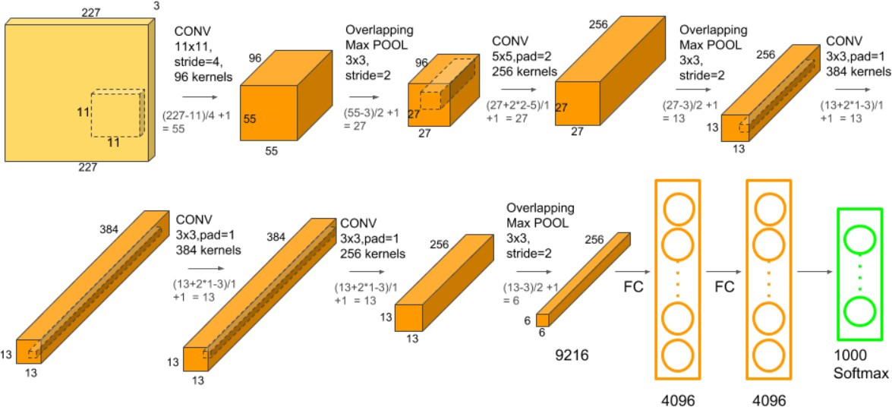
AlexNet architecture:

Slide 11
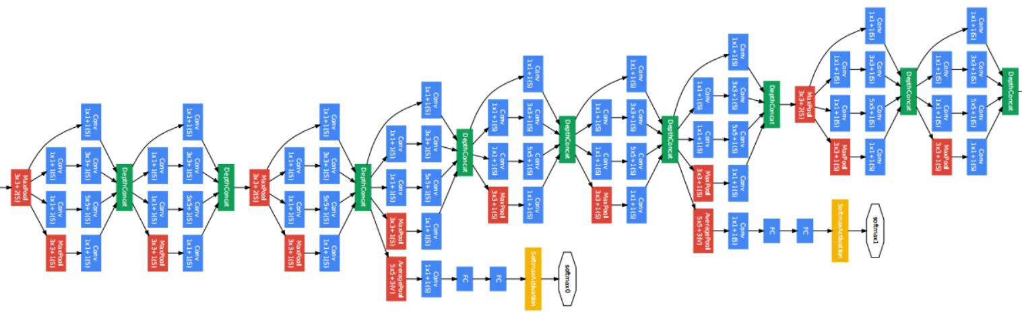
INCEPTION NETWORK
The previous networks perform convolutions layer-by-layer, and the results are input to the next layer. However, inception defines a module that carries out different convolution operations, and finally splices different convolution operations as output. Experimental results show that it has a good performance. The Inception network is different from the general convolution neural network in that it contains multiple convolution kernels of different sizes in its convolution layer, and the output of Inception is the depth stitching of the feature map.

Slide 12
RESIDUAL NETWORK
The residual network has not only made great progress in depth but the architecture is also different from the previous networks. It inserts shortcut connections, which turn the network into its counterpart residual version. The identity shortcuts can be directly used when the input and output are of the same dimensions. The depth of representations is of central importance for many visual recognition tasks. Solely due to extremely deep representations, it obtained a 28% relative improvement on the COCO object detection dataset. Deep residual nets won 1st place on the ImageNet detection tasks, ImageNet localization, COCO detection, and COCO segmentation.

Slide 13
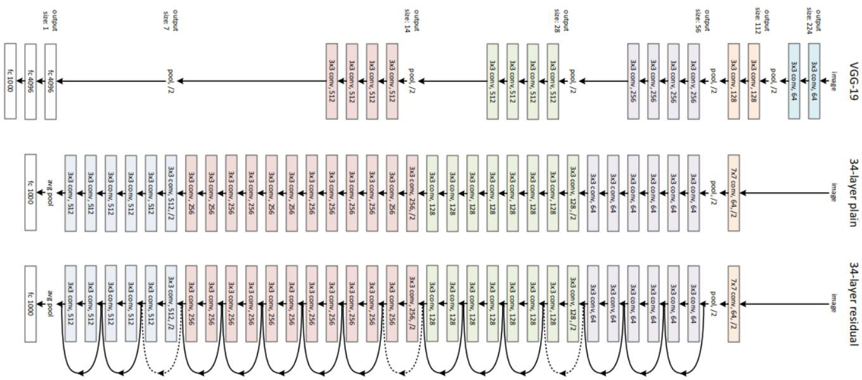
Residual Network

Slide 14
DENSE NETWORK
The dense convolutional network (DenseNet) connects each layer to every other layer in a feedforward fashion. Whereas traditional convolutional networks with L layers have L connections-one between each layer and its subsequent layer-our network has L(L+1)/2 direct connections. For each layer, the feature-maps of all preceding layers are used as inputs, and its feature-maps are used as inputs into all subsequent layers. DenseNets have several compelling advantages: they alleviate the vanishing-gradient problem, strengthen feature propagation, encourage feature reuse, and substantially reduce the number of parameters. It was evaluated on four highly competitive object recognition benchmark tasks (CIFAR-10, CIFAR-100, SVHN, and ImageNet). DenseNets obtain significant improvements over the state-of-the-art on most of them, whilst requiring less computation to achieve high performance.

Slide 15
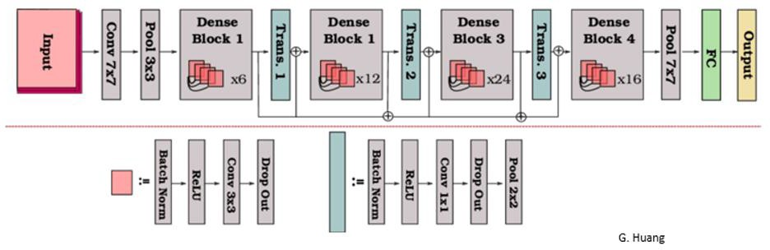
Dense Network

Slide 16
DRAWBACKS OF EXISTING SYSTEM
The above-mentioned models fail to address key problems related to image super resolution and image denoising.
The depth of AlexNet model is very less and hence it struggles to learn features from image sets. We can observe that it takes more time to achieve higher accuracy results compared to other models.
Inception Network have sometimes use convolutions such as 5*5 that causes the input dimensions to decrease by a large margin. This causes the neural network to uses some accuracy decrease.
Resnets include adding skip level connections for which you have taken into account the dimensionality between the different layers which can become a headache.

Slide 17
PROPOSED SYSTEM
We propose Restructured Residual Dense Network (RRDN) to solve the problem of crop leaf disease identification. As the original model was used in image super resolution, the input images have no dimension reduction operation, which may work well in a single block.
But in the image classification task, tens of thousands of images are input, which will require considerably more computing resources, as well as low efficiency.
So, the input image is convolved first in Res-Dense-Block (RDB)and the tensor is batch normalized after the convolution in the RDB block.
In this experiment, the input size of the tensor is 196∗196∗64, then input the 3-layer RDB for feature extraction. Then the output size is 98∗98∗64, which can be used for residual added.
After that, the block output by the 3-layer RDB and the initial input tensor create the residual connection operation and output a new tensor.

Slide 18
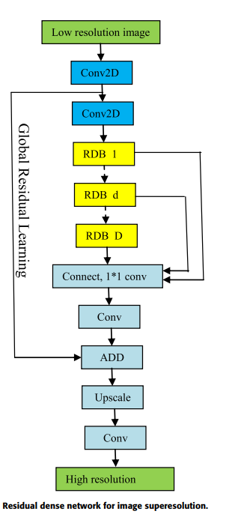

Slide 19
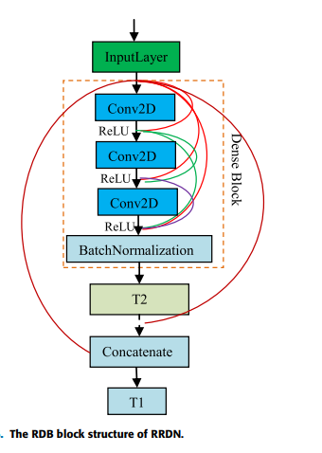
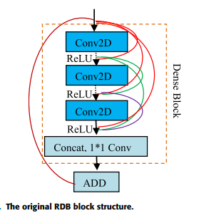
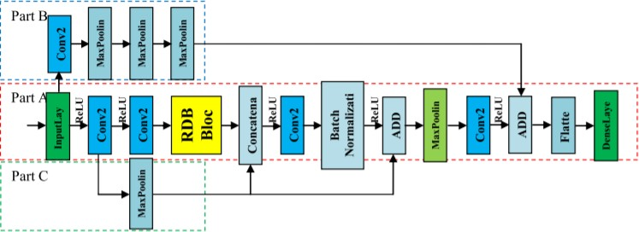

Slide 20
METHODOLOGIES
There are various modules involved in process of classify tomato leaf disease leaves. The modules are listed below:
Dataset
Pre-processing
Data Partition
Constructing RRDN
Defining Activation and Loss Functions
Evaluation

Slide 21
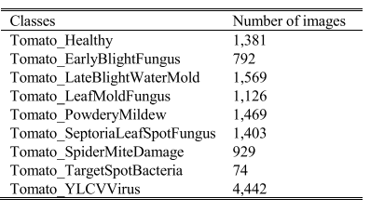
DATASET
The tomato leaf diseases dataset in AI CHALLENGER is used for this experiment, which includes 13,185 images within 9 classes.
The images are the same size of 196∗196 pixels.
The class details are shown in table below.

Slide 22
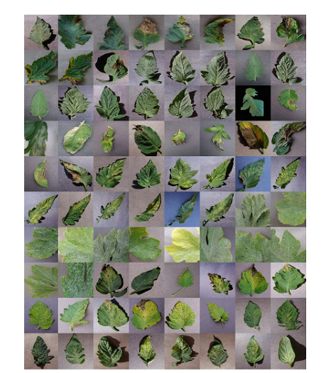
Part of the tomato leaf disease images is shown in the figure below

Slide 23
FUTURE ENHANCEMENTS
This project proposes a residual dense network-based tomato leaf disease identification model; this inspiration comes from RDN in the image super resolution task. By adjusting the model architecture, we transformed it into a classification model, which obtained a higher accuracy than state-of-the-art models. Because this model is suitable for the tomato dataset, we will attempt to perform transfer learning from the tomato dataset to other plants through the model adjustment to improve the generalization ability. In the future, we hope to apply this work in practical work to make a small contribution to developing agricultural intelligence.

Slide 24
Conclusion
Tomato is a very popular food worldwide for food or for seasoning; it is one of the necessities of life. Even for entertainment. The ‘‘Tomatina’’ held each year on the last Wednesday in August originated in Spain where tens of thousands of revelers from around the world pelt each other with tons of tomatoes. To produce better quality tomatoes, people must overcome the problem of plant diseases. Generally, plant diseases appear on the leaves first, which makes the leaf disease identification particularly important.

Slide 25
Thank You😃

